Slide 1
Recommendation system

Slide 2


Slide 3
ACKNOWLEDGEMENT
It gives us a great sense of pleasure to present the synopsis of the B.Tech mini project undertaken during B.Tech III Year. This project is going to be an acknowledgement to the inspiration, drive and technical assistance will be contributed to it by many individuals. We owe special debt of gratitude to Dr Sumit Nagar, Technical Trainer, for providing us with an encouraging platform to develop this project, which thus helped us in shaping our abilities towards a constructive goal and for his constant support and guidance to our work. We also do not like miss the opportunity to acknowledge the contribution of all faculty members of the department for their kind guidance and co-operation.
Divyansh bhargava (201500231)
Anurag Singh (201500127)
Aryan Gupta (201500150)

Slide 4
ABSTRACT
The project aims to generate meaningful recommendations to a collection of users for movies or books that might interest them.Recommender system tries to filter the users' data to come up withthe exact amount of information required according to the needs andpreferences of the users. Hence there is an increase in the demandof recommender system to tackle the data overload.
The ML algorithms for these recommendation systems use the data about this user from the system’s database .
The algorithm is designed to provide the resources in a more easy way sothat the user doesn’t have to search for any movie or book.Through this, the user can save time and see/read their favourite movies/books more efficiently.

Slide 5
INTRODUCTION
In this, we will build one interesting application that will related with the recommendations provided to the users.To build this application we will use HTML, CSS, JavaScript and Python. This is one of the exciting and thrilling applications. While building this application we have used various libraries.
In our Project, there are two recommendation systems, one of which isfor Movies and the other one is of Books. In the Movies section, the userhave to search the movie in the search bar, based on the type of the moviesearched and user personality, the system will show the recommendedmovies to the user.

Slide 6
Process used by our site
Step 1: Welcome to the recommendation system site.
Step 2: Go to services.
Step3: Choose one option book recommendation or movie recommendation.
Step 4: If we choose movie recommendation option then search for a movie , we will get all other similar movies.
Step 5: If we choose book recommendation option then search for a book, we will get all other similar books.

Slide 7
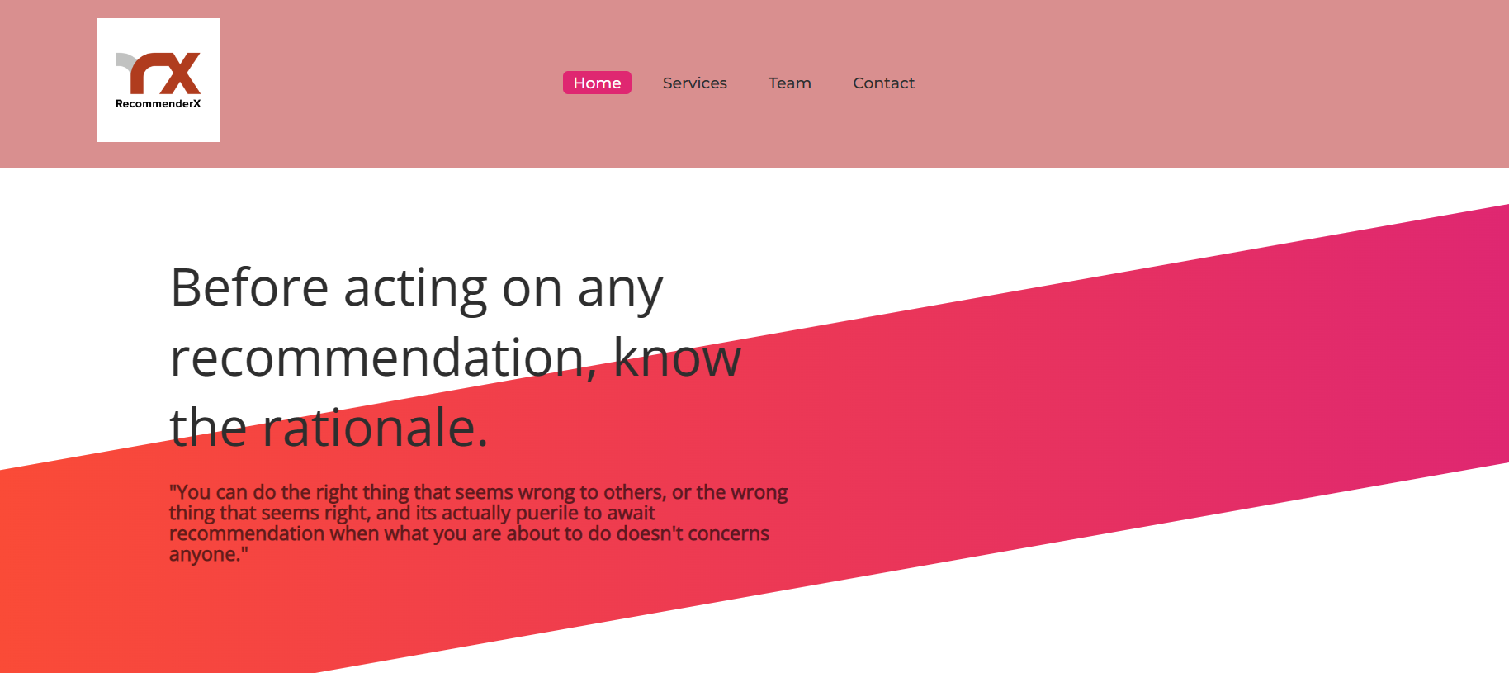

Slide 8
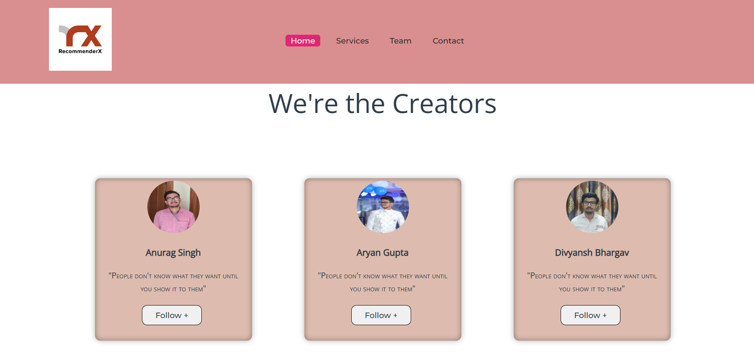

Slide 9


Slide 10
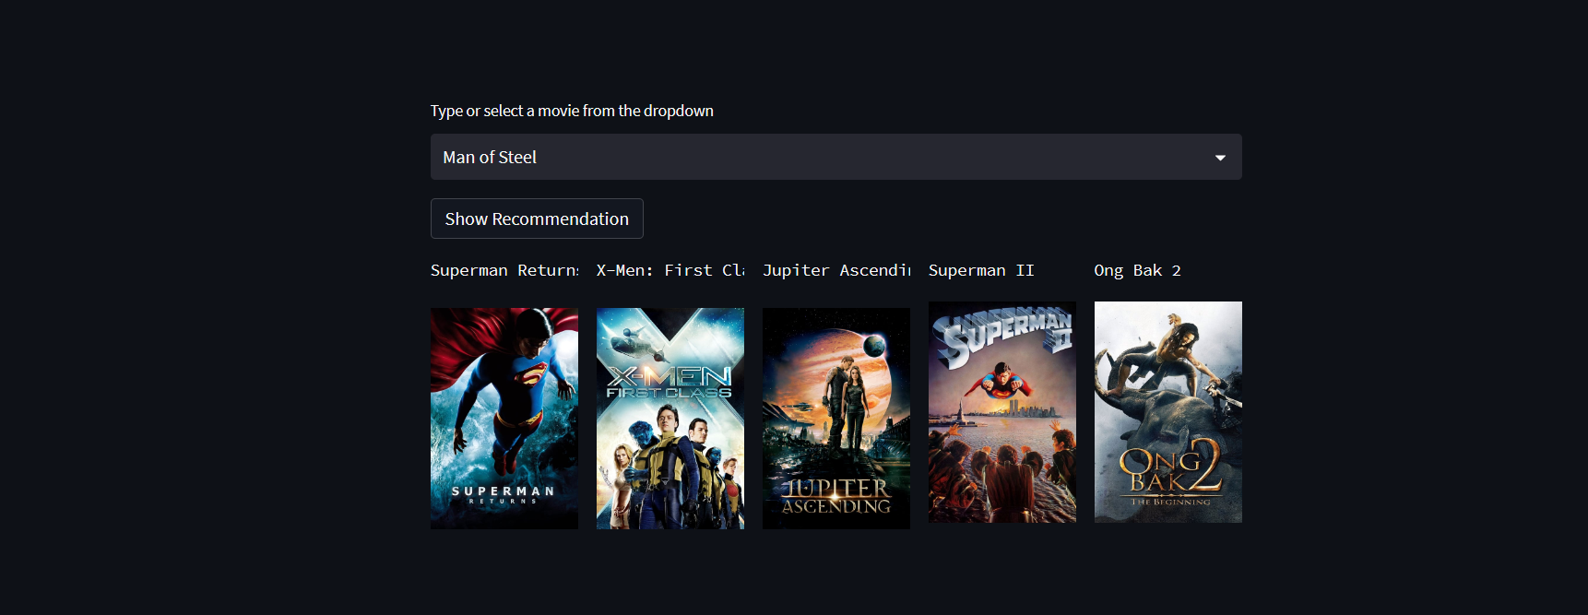

Slide 11
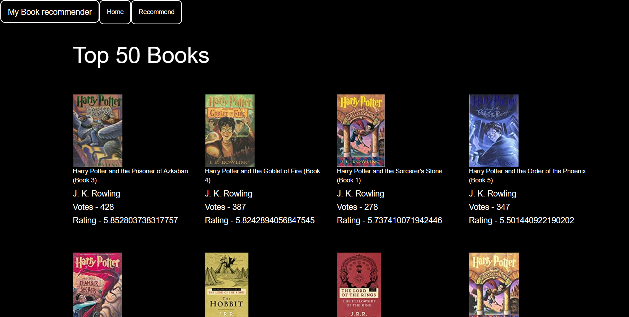

Slide 12
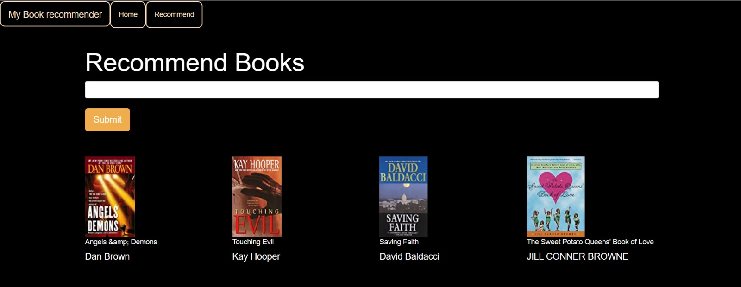

Slide 13
MOTIVATION
The primary goal of movie recommendation systems is to filter and predict only those movies that a corresponding user is most likely to want to watch. The ML algorithms for these recommendation systems use the data about this user from the system’s database. This data is used to predict the future behavior of the user concerned based on the information from the past.

Slide 14
FUTURE SCOPE
There is a future scope of this facility that many more features such as online lectures and video tutorials can be added as well as online pdf, Previous Year Question papers are uploaded to the submission facility, Scheduler helps them to schedule their study routine a feature of feedback and online group discussions among students where they can discuss various issues of engineering subjects can be added to this project thus making it more interactive more user friendly and project which fulfills each users need in the best way possible.

Slide 15


